Slide 1
Banneker School Transportation

Slide 2
Banneker Elementary School opened in 1948 as a solution to overcrowded ‘colored’ schools
School buses driven by adult and student bus drivers drove buses to Banneker
Students that lived close by (such as those in St. Louis) walked to Banneker
Banneker also served as a transfer point for students attending Douglass High School (Bus 16)
LCPS records shown herein document those drivers, the buses they drove and the routes they traveled

Slide 3
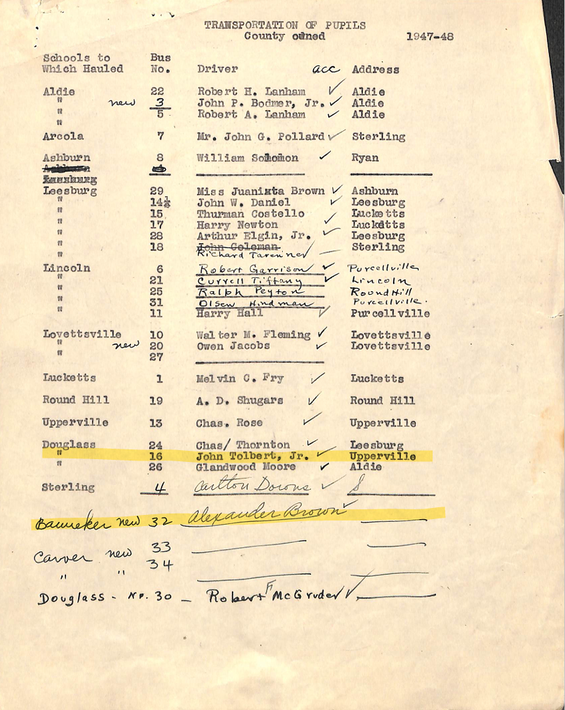
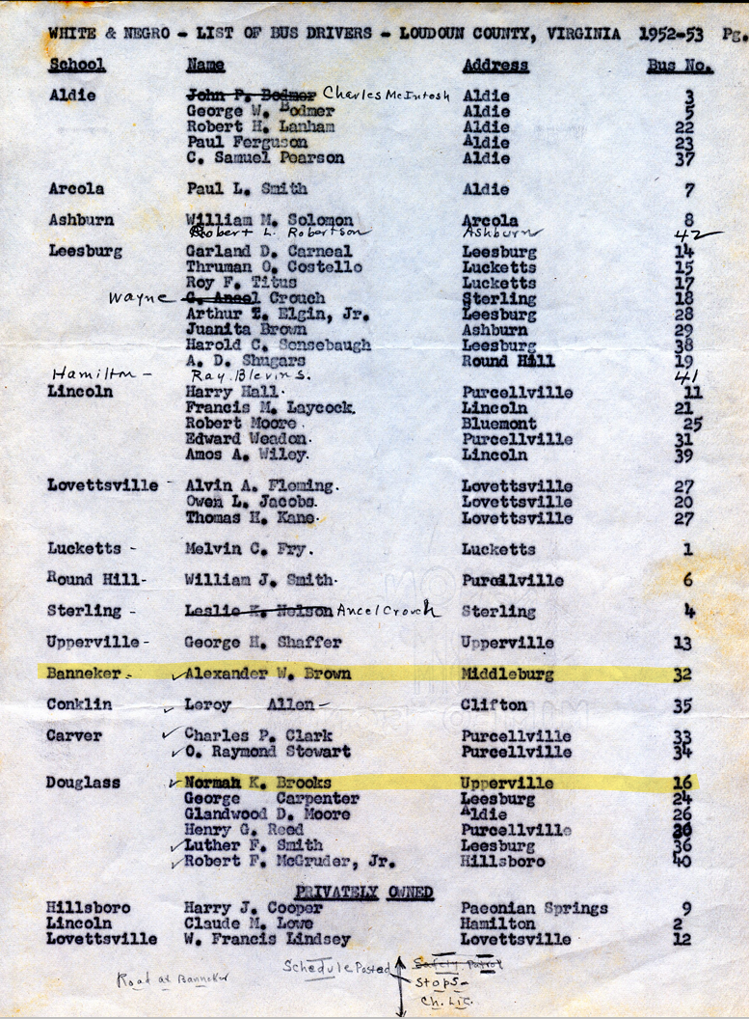
. . .

Slide 4
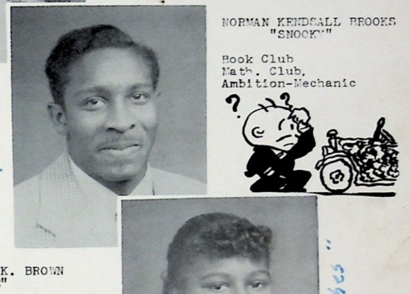
Student Bus Driver Norman Brooks, Class of 1955 Douglass High School
Picture courtesy Gertrude Evans

Slide 5
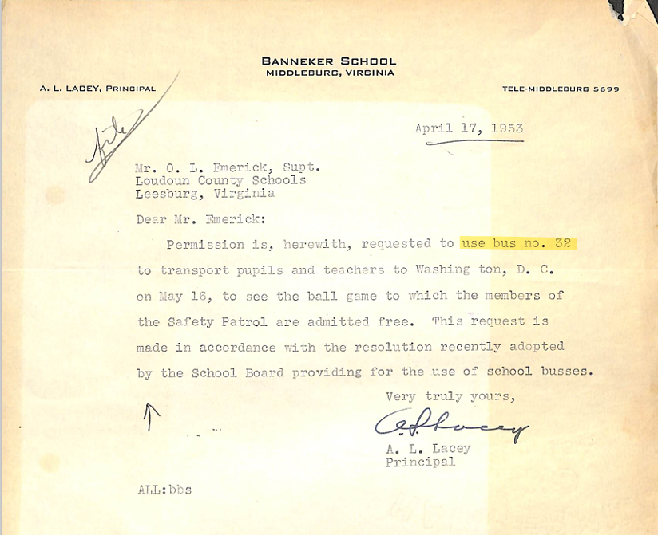
On May 16, 1953 the Washington Senators played the St. Louis Browns at Washington D.C.’s Griffith Stadium.
Banneker Elementary is located in the village of St. Louis, so the choice of this particular game, was likely intentional.

Slide 6
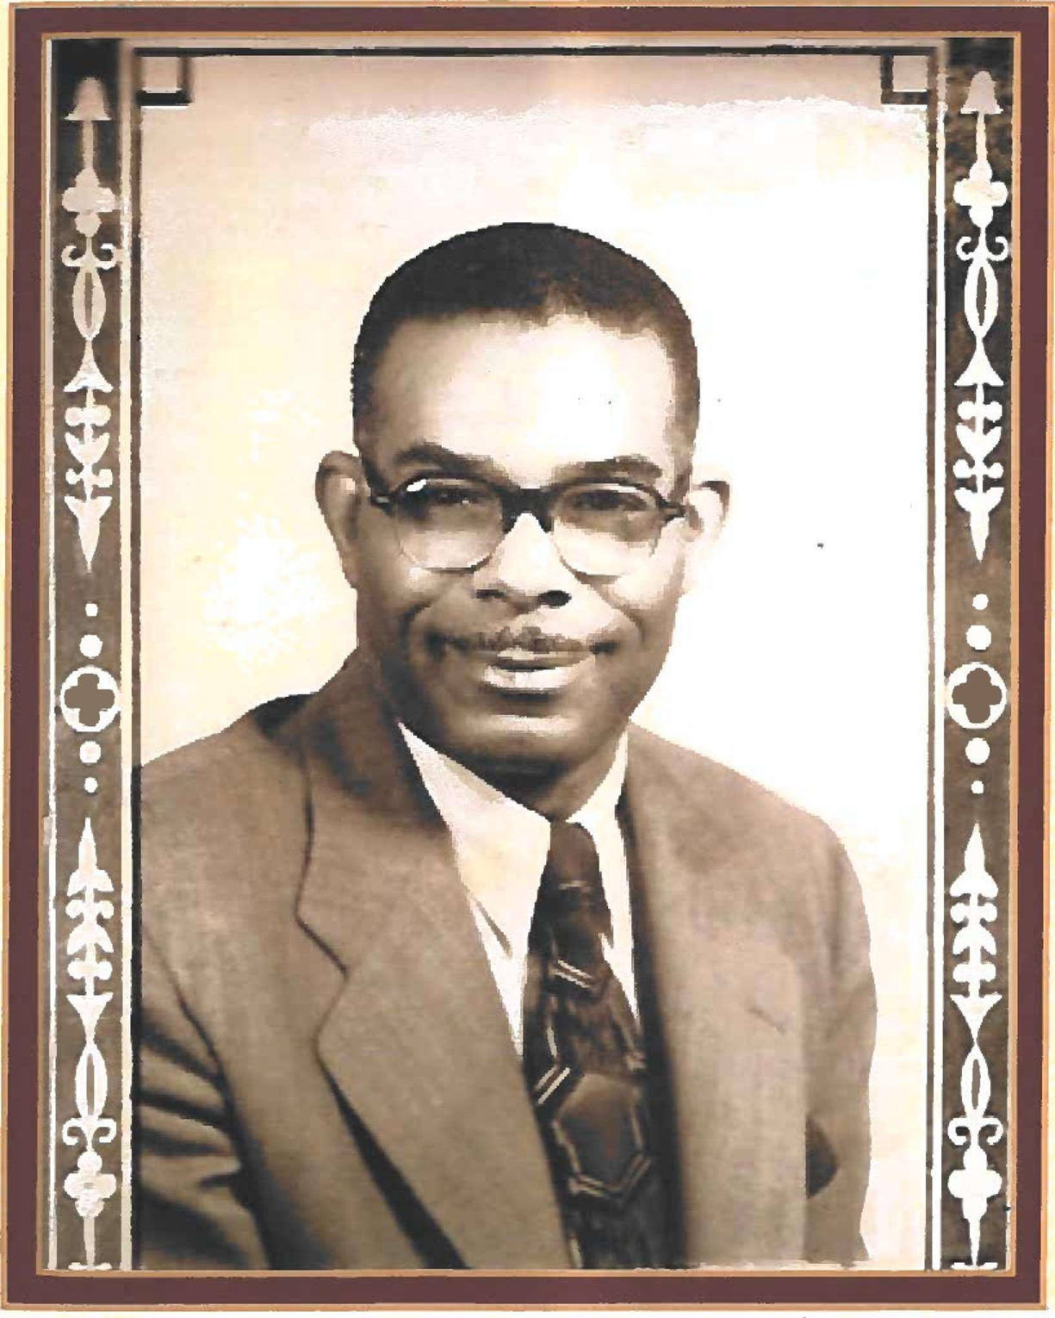
Banneker Principal Mr. Augustus L. Lacey 1947-1953
Picture courtesy Banneker Elementary Principal Mr. Robert Carter

Slide 7
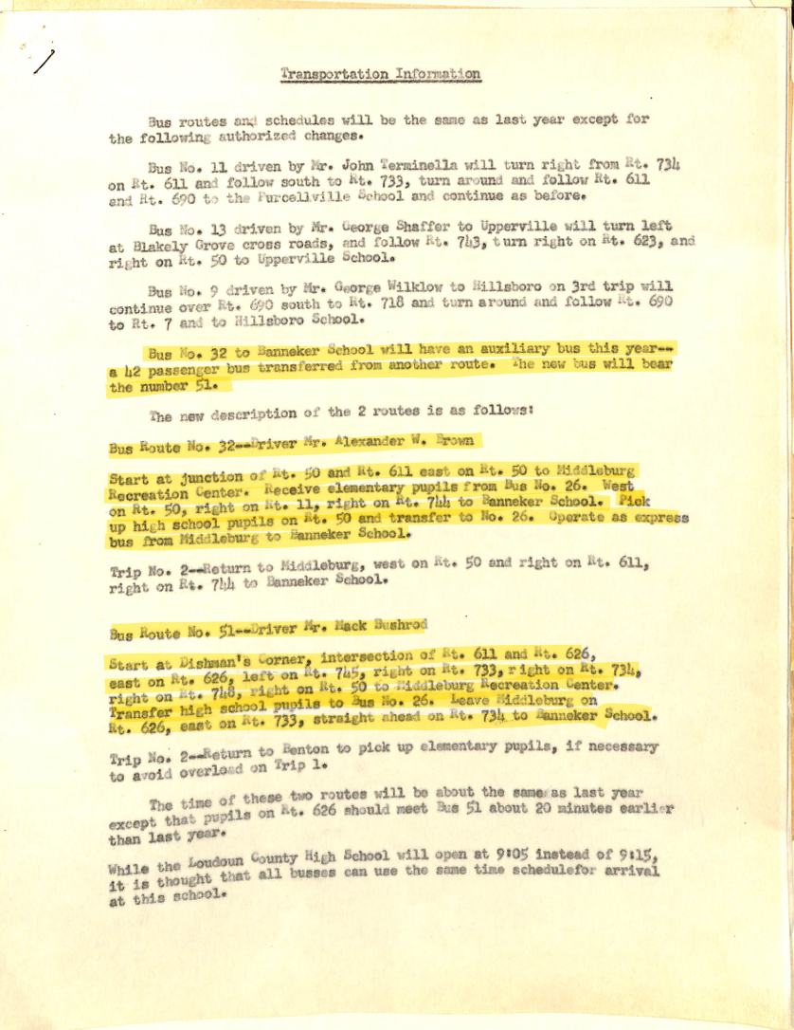
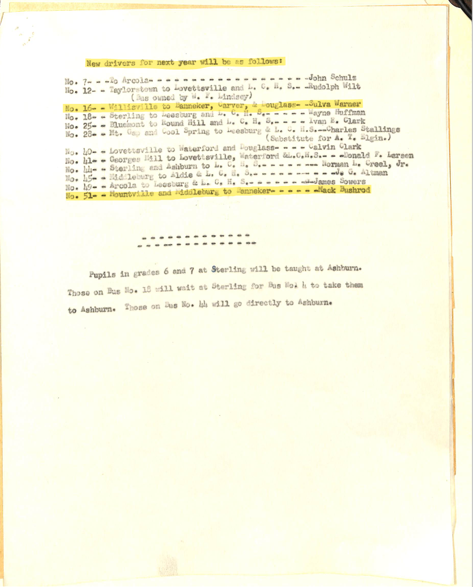
1954

Slide 8
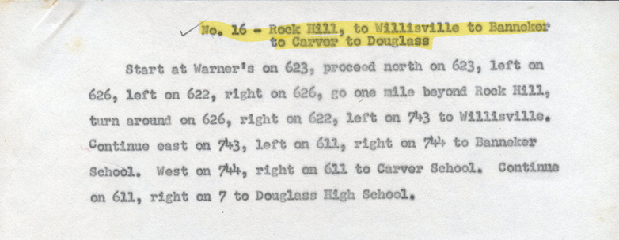
1955 Bus Route

Slide 9
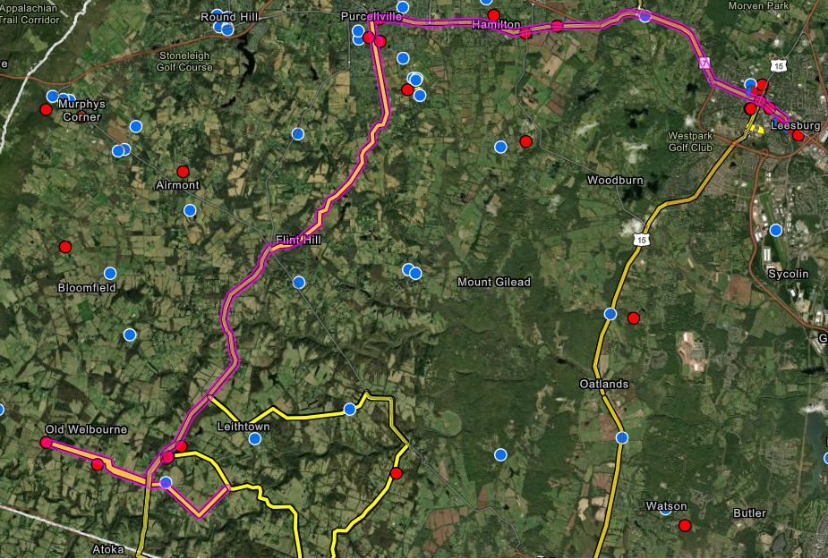
Carver
Douglass
Bus Route
16
Banneker
Willisville

Slide 10
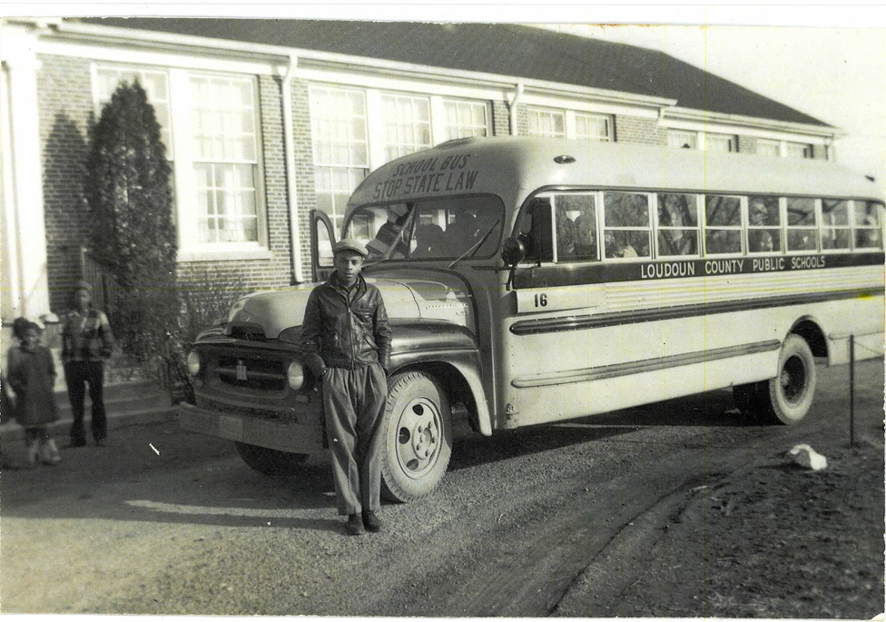
Sulva Warner and Bus 16 in front of Carver 1955

Slide 11
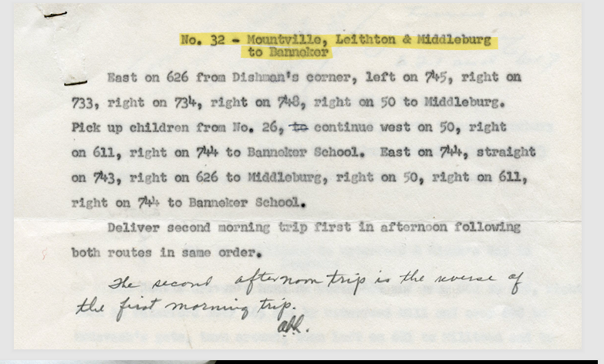
1955 Bus Route

Slide 12
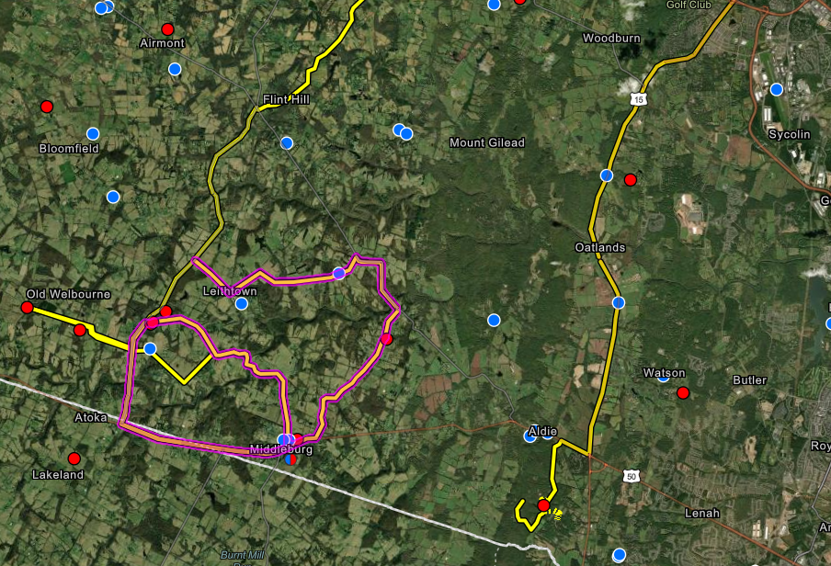
Bus Route
32
Banneker

Slide 13
